Slide 1

Portfolio Milestone Presentation
By Barbara Schweitzer

Slide 2
Introduction
Upon successful completion of the projects and courses in the Applied Data Science Program, students will have successfully learned and applied the 7 learning outcomes:
Describe a broad overview of the major practice areas in data science.
Collect and organize data.
Identify patterns in data via visualization, statistical analysis, and data mining.
Develop alternative strategies based on the data.
Develop a plan of action to implement the business decisions derived from the analyses.
Demonstrate communication skills regarding data and its analysis for managers, IT professionals, programmers, statisticians, and other relevant professionals in their organization.
Synthesize the ethical dimensions of data science practice (e.g., privacy).

Slide 3

IST 707 – Data Analytics

Slide 4
IST 707 – Data Analytics
Medical data analysis performed in R
Breast cancer data
Created multiple models to attempt to predict outcomes based on cancer patient attributes
Decision tree model
Naïve Bayes model
K-Nearest Neighbor models

Slide 5
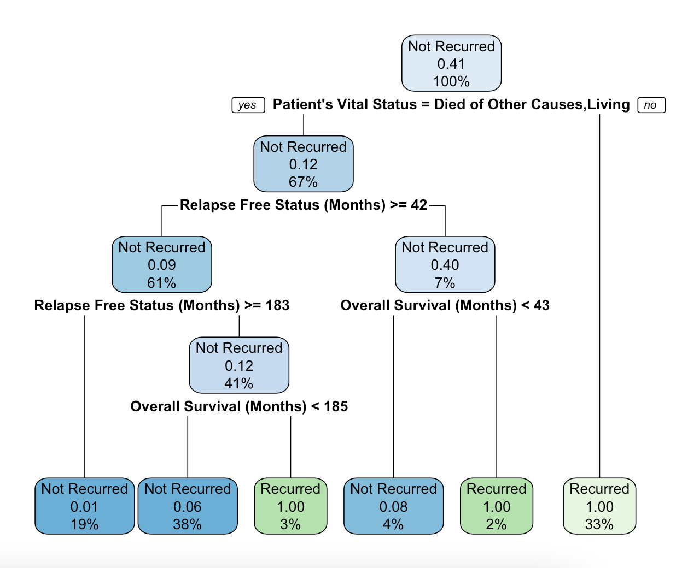
IST 707 – Data Analytics

Slide 6
IST 707 – Data Analytics
Learning Goals Reflection
Medical data highlighted proper data collection and privacy
Flexibility in response to undesirable results
Following the story of the data
Introduced a major specialized area of data science

Slide 7

MAR 653 – Marketing Analytics

Slide 8
MAR 653 – Marketing Analytics
Voter survey data was analyzed in Excel
Questionnaire question data
Business question formulated to be answered after analysis
How can we encourage voter participation on college campuses and among younger people?
Logistic regression analysis performed
Demographic variables
Survey question responses

Slide 9
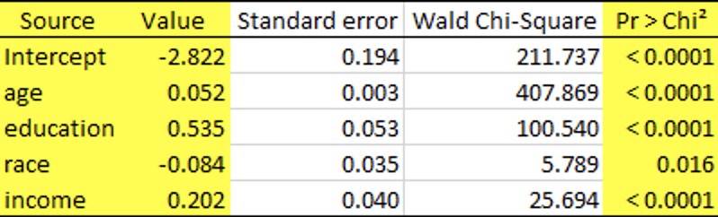
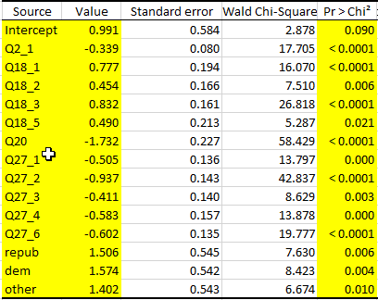
MAR 653 – Marketing Analytics

Slide 10
MAR 653 – Marketing Analytics
Learning Goals Reflection
Collected and researched real world data
Skew in the data required a new approach to the analysis
Professional presentation to an audience

Slide 11

IST 664 – Natural Language Processing

Slide 12
IST 664 – Natural Language Processing
Product review text data analyzed in Python
Amazon musical instrument review data
Extracted useful information from reviews to predict ‘good’ or ‘bad’ rating given to product
Text analysis performed
Removed non-alphabetic characters and stop words
Lemmatized and tokenized text
Created multiple models to predict the rating
Naïve Bayes (standard with cross validation and multinomial)
Linear regression

Slide 13
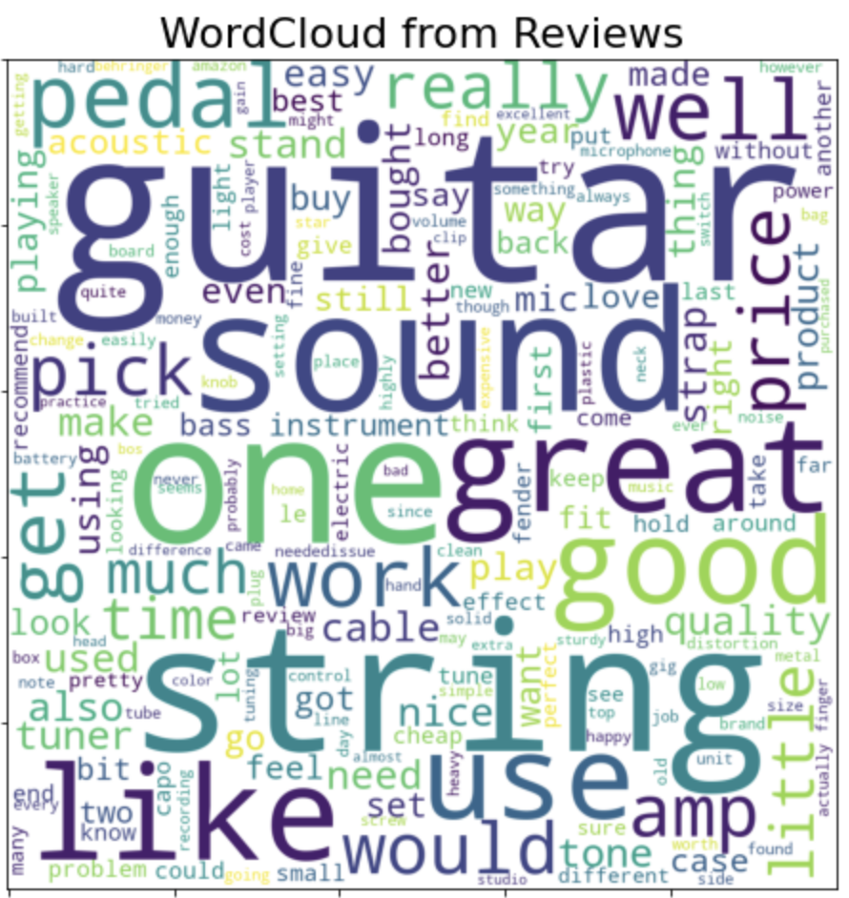
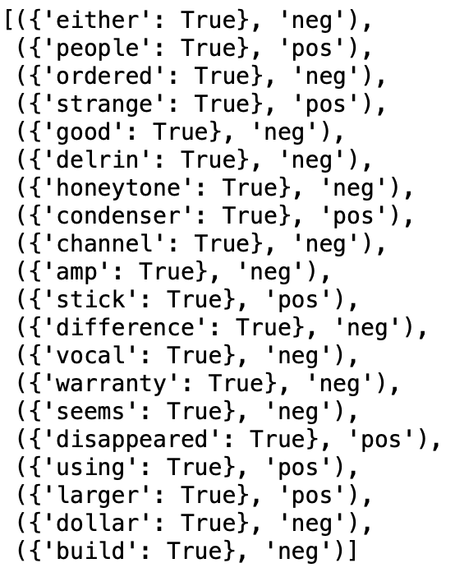
IST 664 – Natural Language Processing

Slide 14
IST 664 – Natural Language Processing
Learning Goals Reflection
Collected and researched real world data
Identified important patterns in the data
Skewed data required an open mind and willingness to change strategies

Slide 15

IST 719 – Information Visualization

Slide 16
IST 719 – Information Visualization
Chess game data analyzed in R
Lichess.org game data set
Visualizations created in R and Adobe Illustrator
Rating distributions by first game move
Rating distributions by piece color
Histogram of number of turns
Barplot of game endings
Scatterplot of rating matches

Slide 17
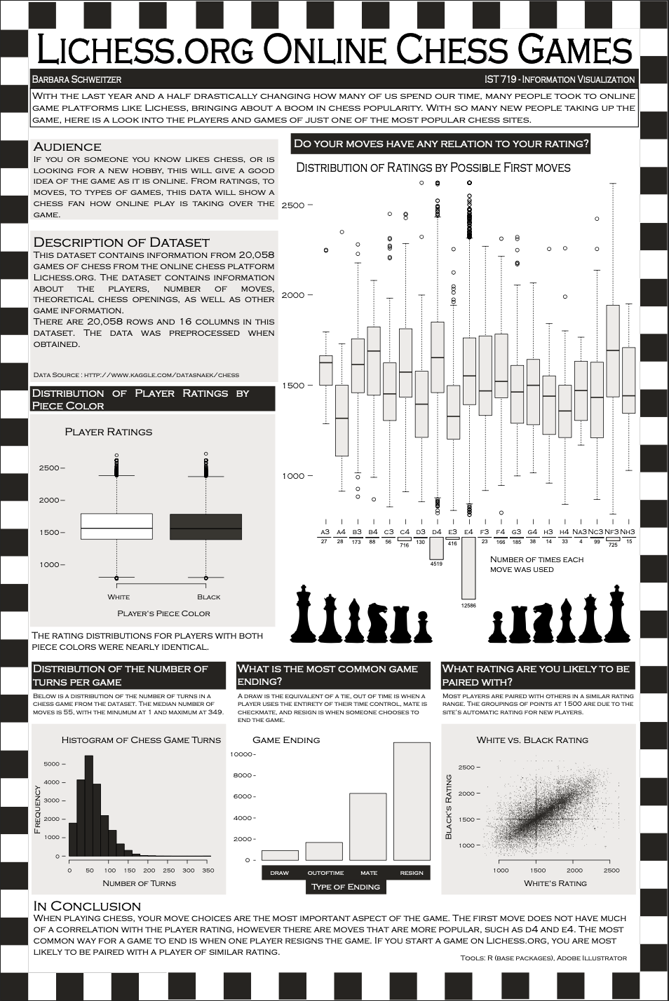
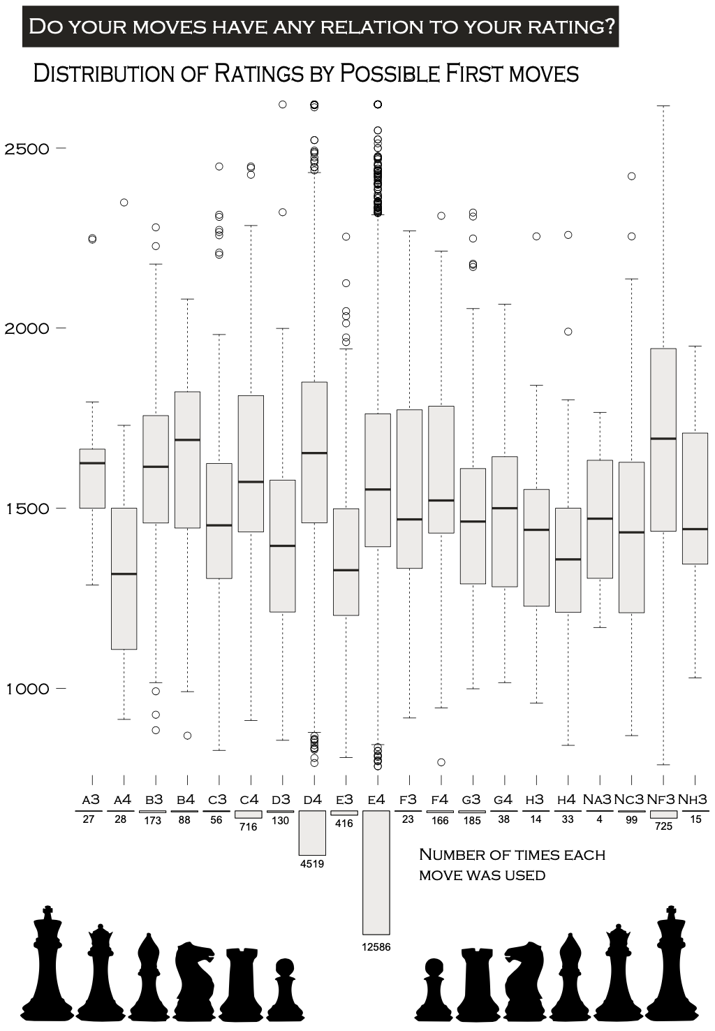
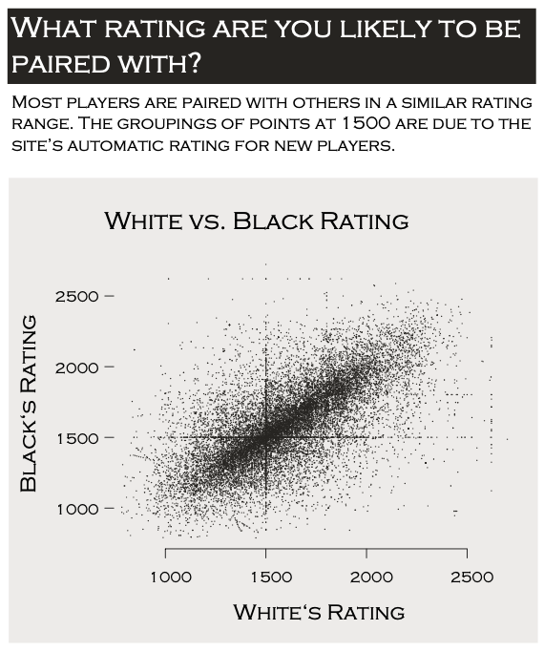
IST 719 – Information Visualization

Slide 18
IST 719 – Information Visualization
Learning Goals Reflection
Searched for and found real world data
Created professional visualizations
Understood the importance of visualization principles
Formulated questions based on the data
Will give a professional presentation to an audience

Slide 19
Conclusion
Through the successful completion of these projects, along with others throughout the program, the learning outcomes have been successfully implemented.
Experienced major practice areas of the field
Data collection for each project
Created models and ran statistical testing on data
Highlighted the importance of flexible data analysis plans
Formulated business questions based on the data
Developed effective communication of the data story

Slide 20
Thank you

Slide 21
References
Schweitzer, B.J. (2021) IST 707: Data Analytics. Retrieved from
https://github.com/bschwei/Syracuse_Portfolio_Milestone/tree/main/IST%20707%20-%20Data%20Analytics
Schweitzer, B.J. (2021) MAR 653: Marketing Analytics. Retrieved from
https://github.com/bschwei/Syracuse_Portfolio_Milestone/tree/main/MAR%20653%20-%20Marketing%20Analytics
Schweitzer, B.J. (2021) IST 664: Natural Language Processing. Retrieved from
https://github.com/bschwei/Syracuse_Portfolio_Milestone/tree/main/IST%20664%20-%20Natural%20Language%20Processing
Schweitzer, B.J. (2021) IST 719: Information Visualization. Retrieved from
https://github.com/bschwei/Syracuse_Portfolio_Milestone/tree/main/IST%20719%20-%20Information%20Visualization
https://github.com/bschwei/Syracuse_Portfolio_Milestone

Slide 22
Image Sources
https://www.google.com/url?sa=i&url=https%3A%2F%2Fteach.com%2Fonline-ed%2Feducation-degrees%2Fonline-masters-library-science%2Fschool-profile-syracuse%2F&psig=AOvVaw04oTi82C1YmqK1CrR19xeH&ust=1631114764169000&source=images&cd=vfe&ved=0CAsQjRxqFwoTCJjgxJqW
https://www.google.com/url?sa=i&url=https%3A%2F%2Fwww.clipartmax.com%2Fmiddle%2Fm2i8A0b1N4b1d3b1_database-clipart-analytic-data-analysis%2F&psig=AOvVaw3KKNP9xHJoukAVxAfRXF29&ust=1631116160670000&source=images&cd=vfe&ved=0CAsQjRxqFwoTCPDMxK-b7fICFQAAAAAdAA
https://www.google.com/url?sa=i&url=https%3A%2F%2Fexpressanalytics.com%2Fsolutions%2Fcustomer-data-platform%2Fmarketing-analytics%2F&psig=AOvVaw30JHivGyvszxx5GDE8GdPs&ust=1631116396654000&source=images&cd=vfe&ved=0CAsQjRxqFwoTCJimsKOc7fICFQAAAAAdAAAAABAD
https://www.google.com/url?sa=i&url=https%3A%2F%2Fwww.defteam.com%2Fnlp-and-text-analysis%2F&psig=AOvVaw2-5FF6kRZzk06pCv1WOO9W&ust=1631116508286000&source=images&cd=vfe&ved=0CAsQjRxqFwoTCJC5yNqc7fICFQAAAAAdAAAAABAK
https://www.google.com/url?sa=i&url=https%3A%2F%2Fwww.subpng.com%2Fpng-ncfkfj%2F&psig=AOvVaw2AsMbOK4D4J7055lmlRB98&ust=1631116727266000&source=images&cd=vfe&ved=0CAsQjRxqFwoTCOiX18Cd7fICFQAAAAAdAAAAABAJ

